Slide 1
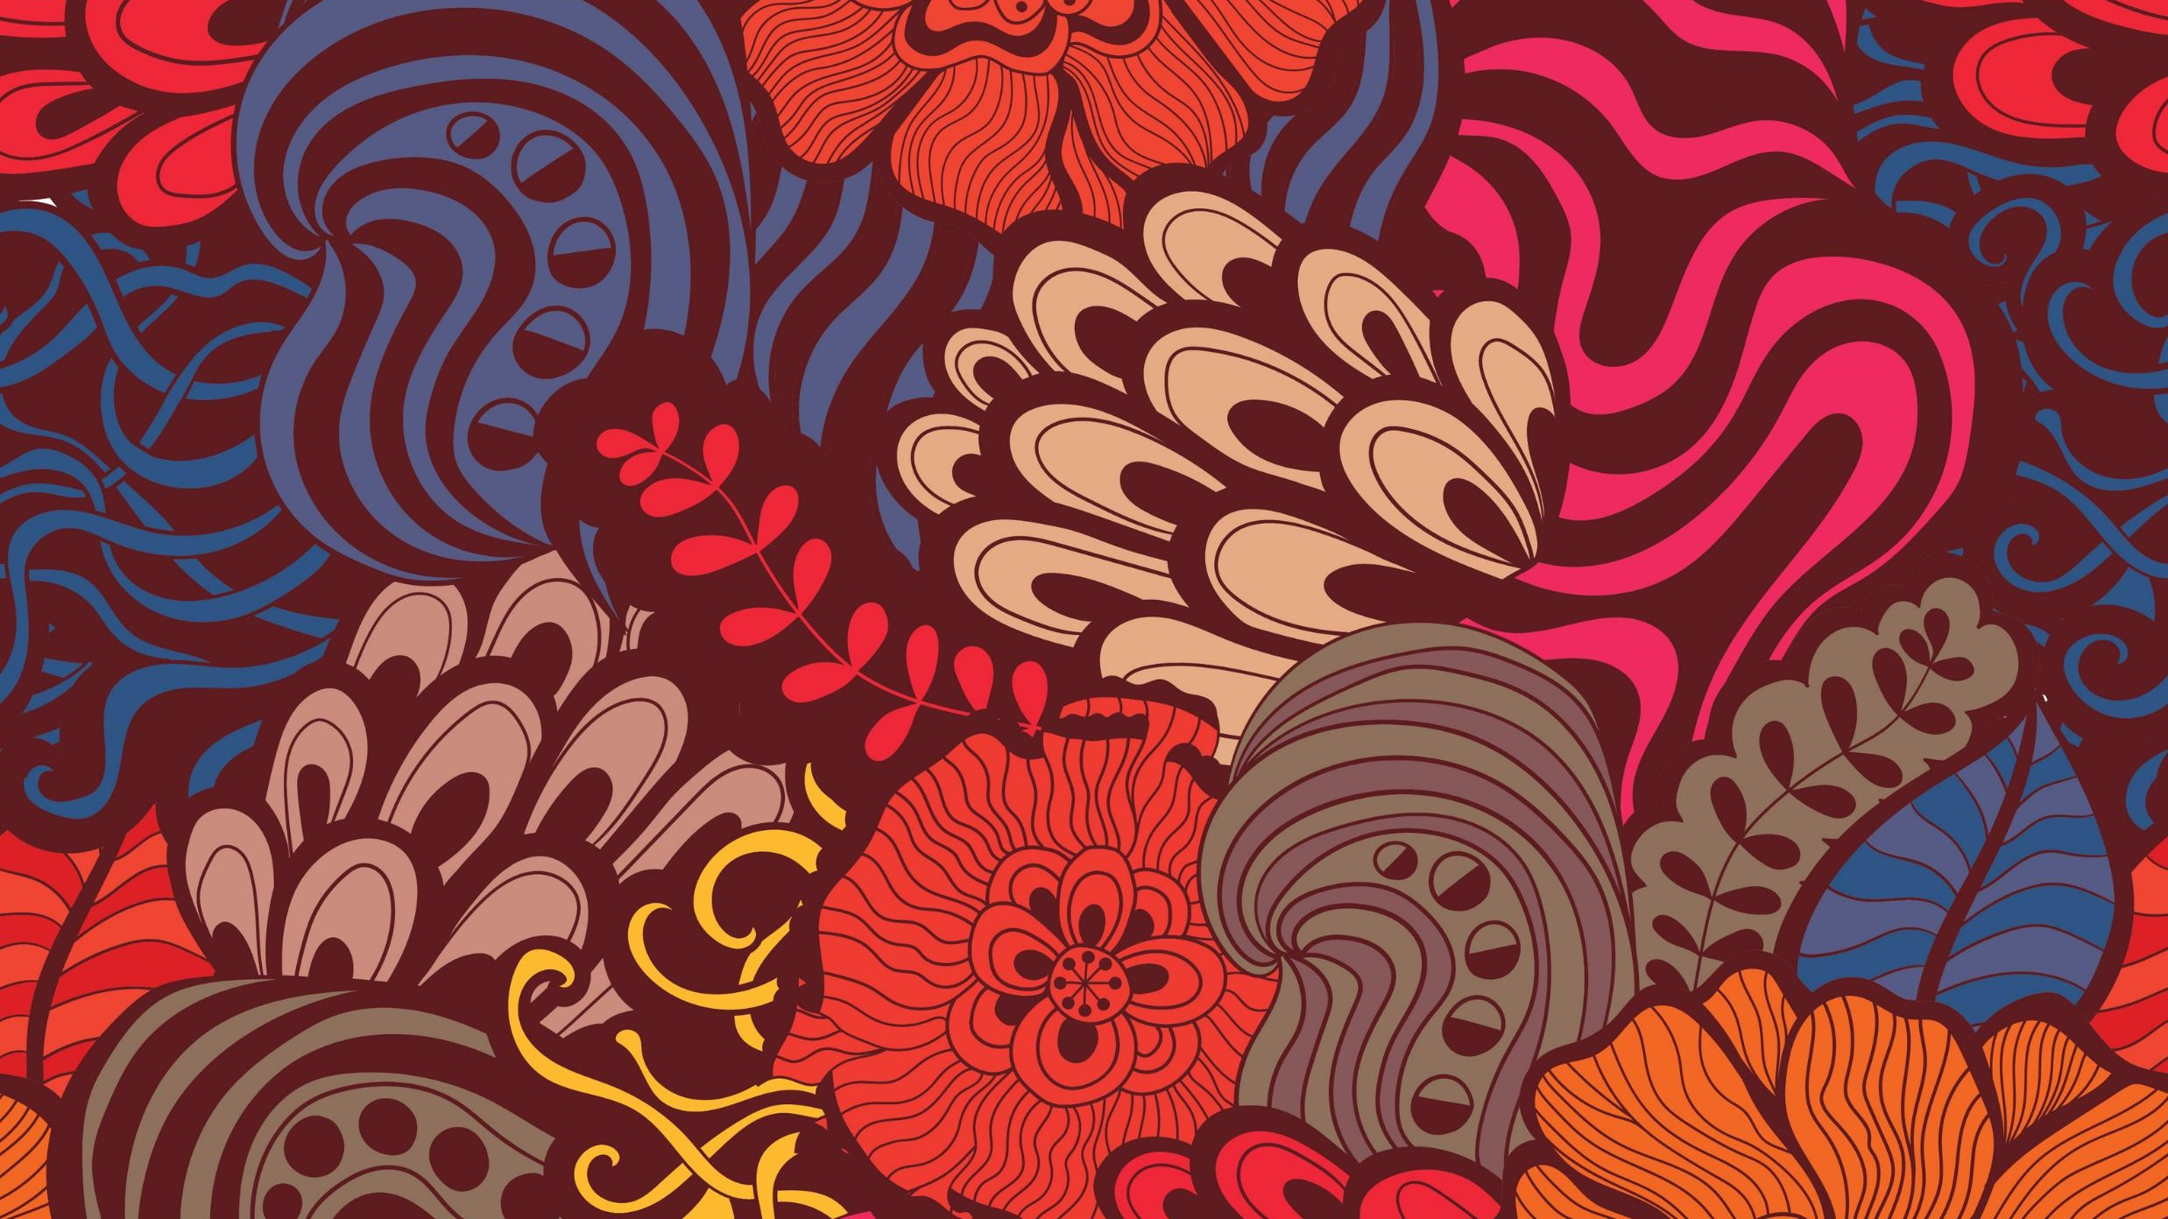
Native American Prayer and Smudging

Slide 2
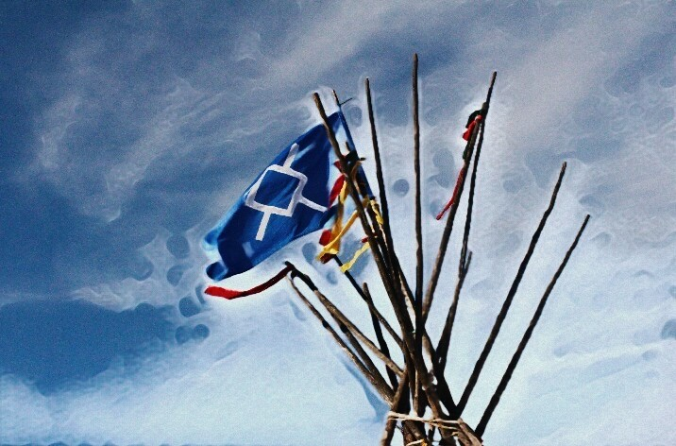
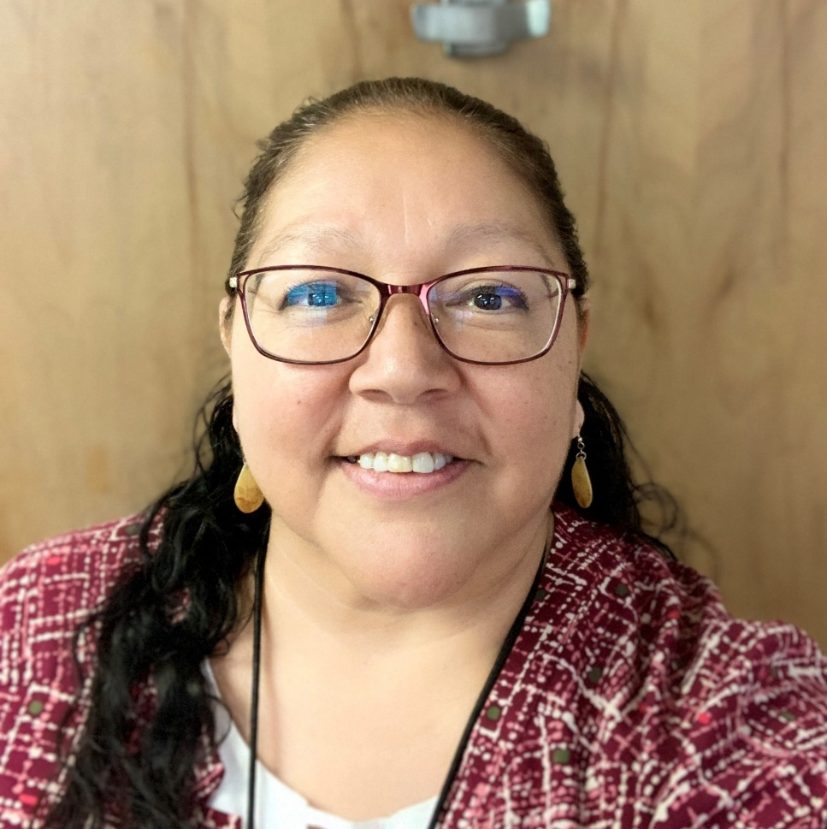
My name is Gina Littlewolf-Millegan and I am a member of the Northern Cheyenne Tribe. My Cheyenne name is Kills Night Woman, Taa'évena'hané'e

Slide 3
Federal and State Recognized Tribes
Total of 574 tribes were recognized by the Bureau of Indian Affairs
Tribes can have federal or state recognition
Montana has 7 reservations

Slide 4
all tribes do Not practice the same ceremonies, customs and beliefs

Slide 5

Northern Cheyenne Practices
Traditional Sweat
Sundance
Peyote Meetings
Daily prayer/meditation
Fasting

Slide 6
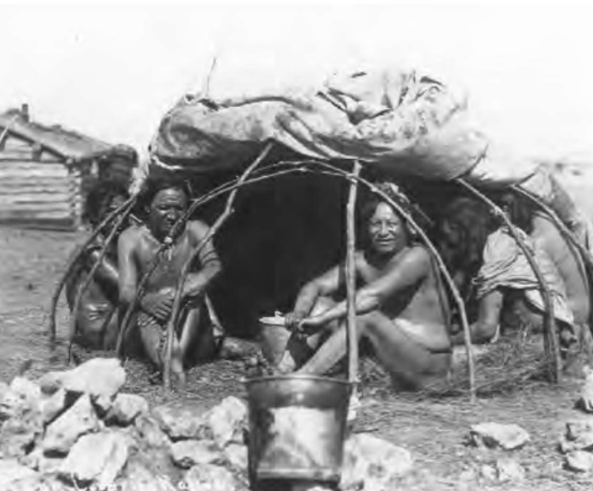
Traditional
Sweats
NC Tribe practices sweats where men and women sweat together, clothes are worn.
Cleansing ceremony with sharing stories, singing and prayer while inside the lodge.
Hot rocks placed from fire inside sweat lodge and water is poured on rocks.
Usually consists of 4 rounds of prayer. Meal is provided afterwards.

Slide 7
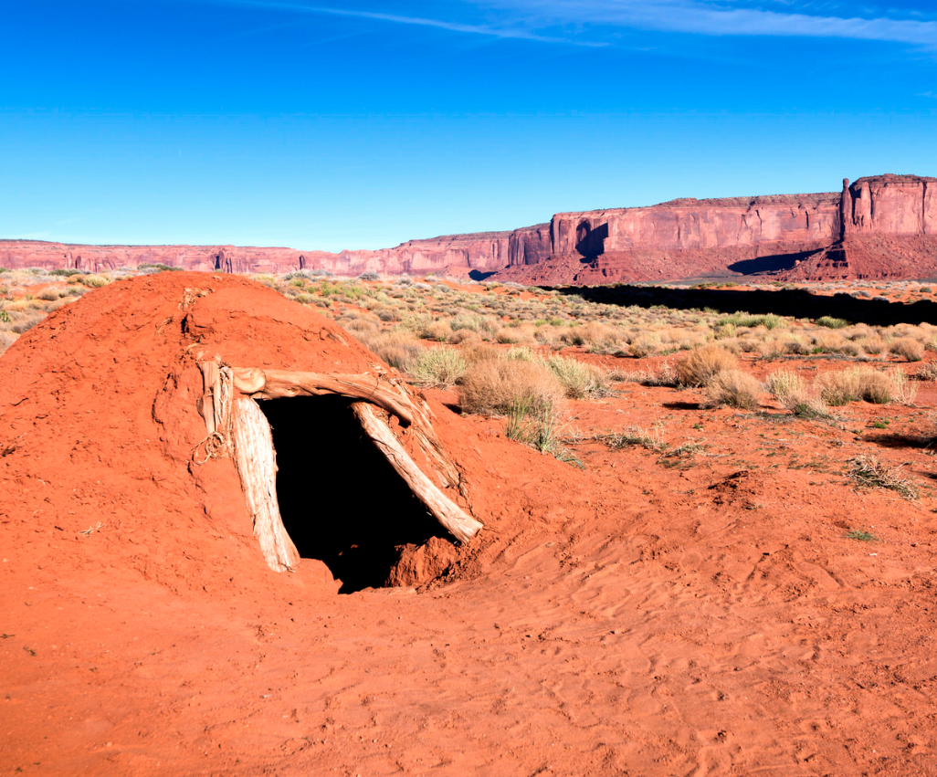
Sweat Lodge
Navajo sweat lodge.
Most sweats for all tribes are followed by a meal and fellowship.

Slide 8
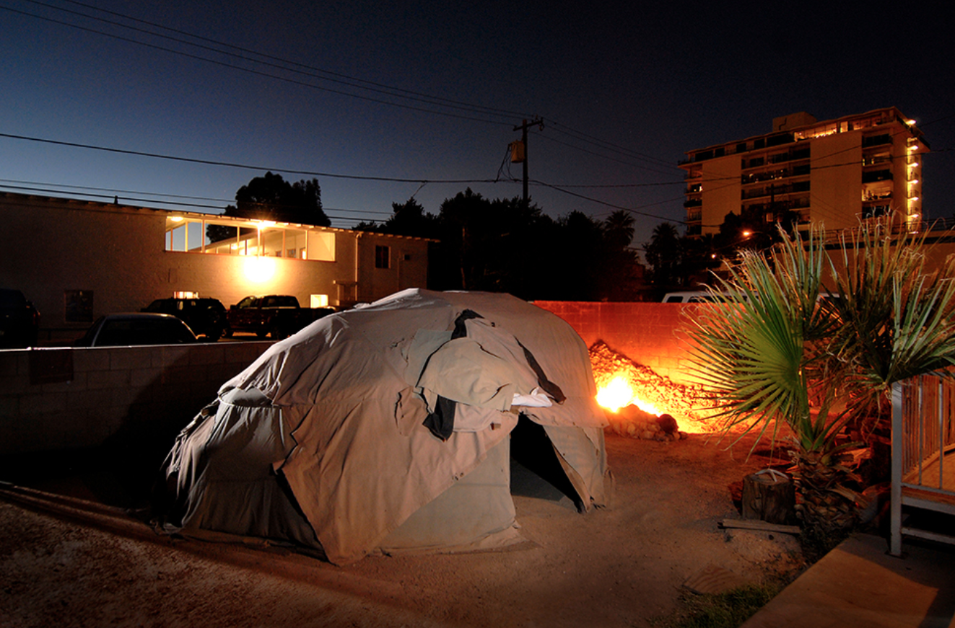
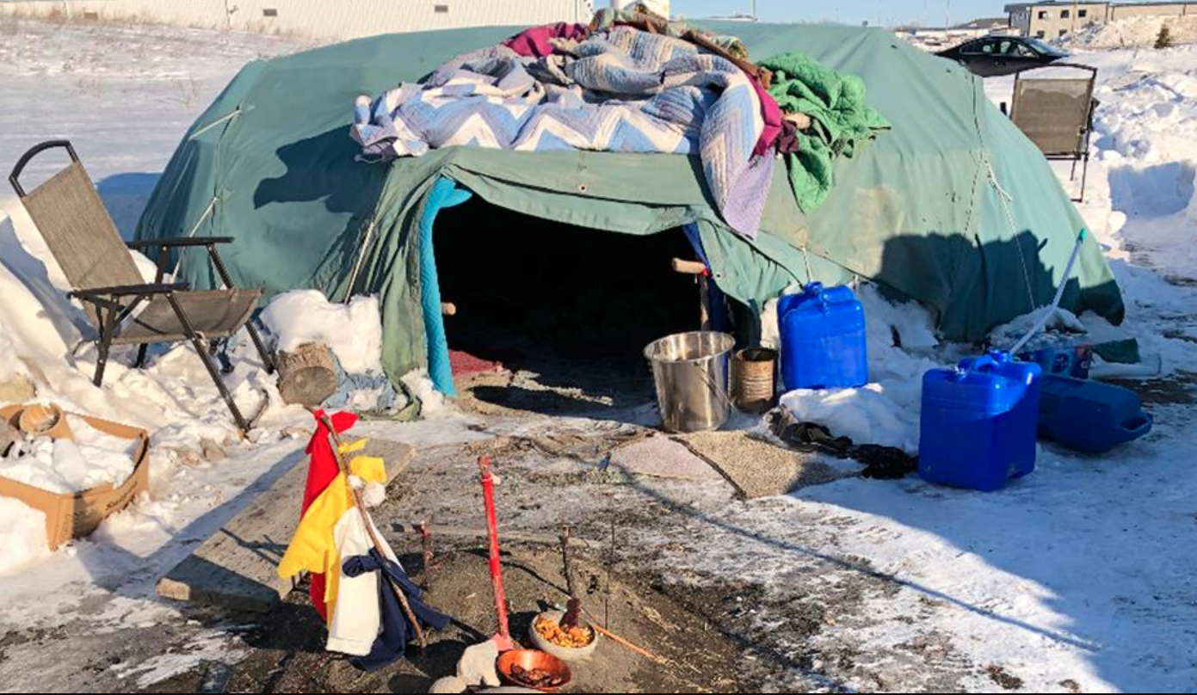
Sweat Lodge
Sweat lodges can be located any where.
Sweats happen during anytime of the year.
Integral part of healing for people suffering from PTSS, substance abuse recovery, spiritual well being.

Slide 9
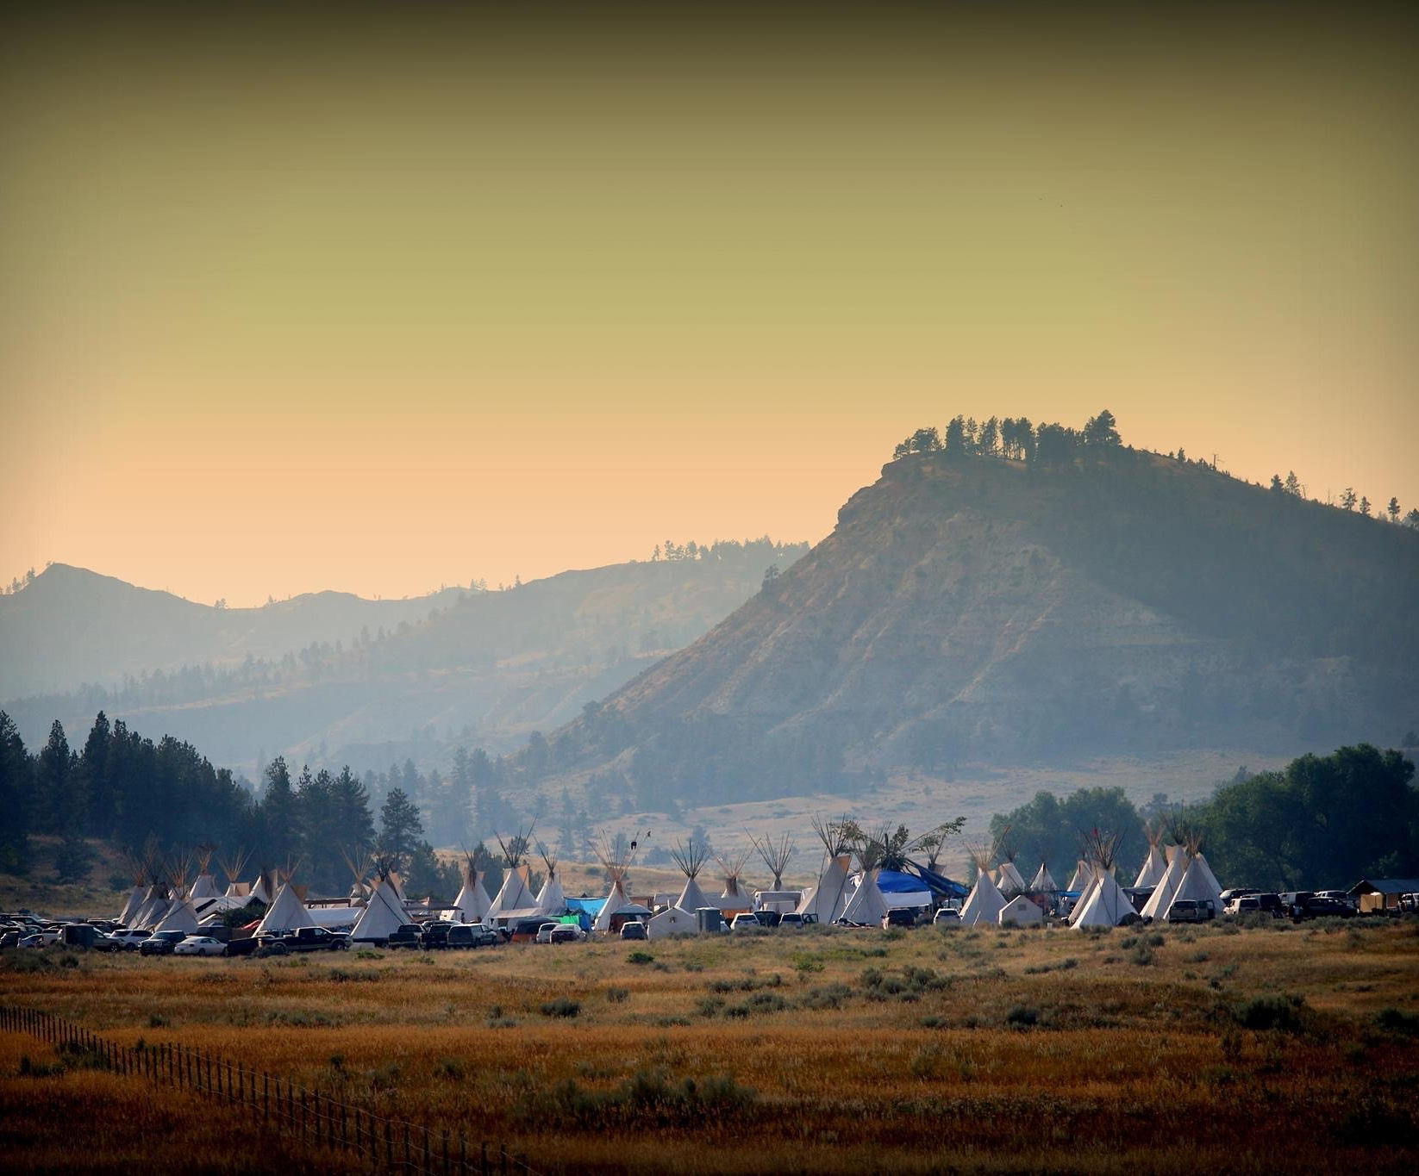
Sundance
Yearly event, may be more than one per year.
Fasting for 3 days: praying, singing and dancing for many different reasons. Personal need or for sick family member.
NC tribe usually 4 times. More if needed for health issues.

Slide 10
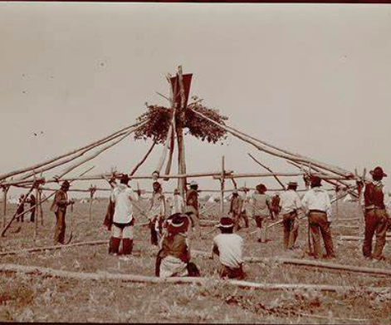
Cheyenne Sundance
Sundance is the Cheyenne New Year, a time of renewal for the people.
The Sacred Arrows are renewed first. The Sacred Hat bundle is present.
Different paints, you pick your sponsor/painter.
Fast and pray, dancers entering lodge Friday and ending Sunday.

Slide 11
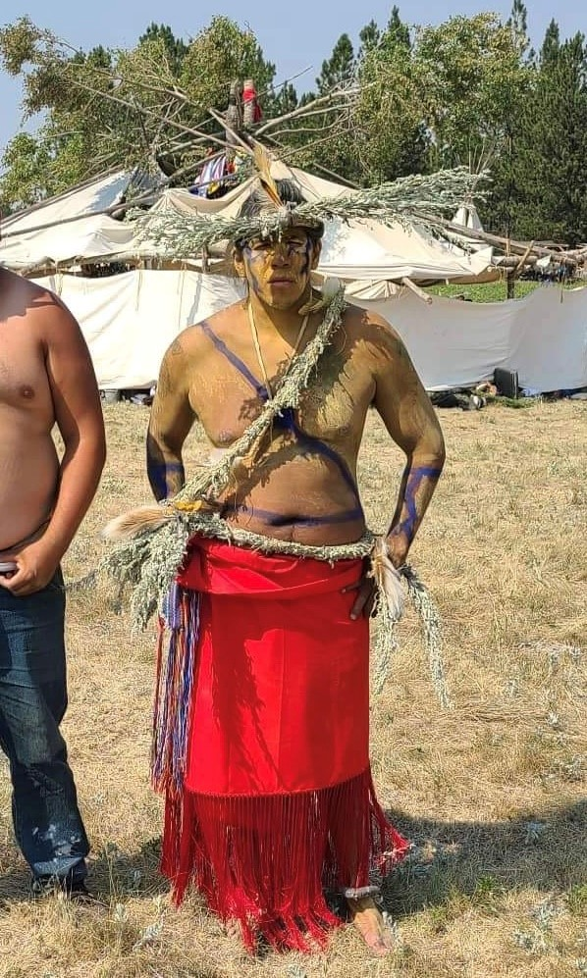
Northern Cheyenne Sundance
No pictures of inside the lodge during the ceremony or pledgers inside lodge are allowed.
The women do not dance in the Northern Cheyenne culture
No blood is allowed inside the lodge
Different types of piercing is done with other tribes, is a flesh offering.

Slide 12
Sacred Hat Bundle and Sacred Hat Keeper
The Cheyenne People were once one tribe. When the bands split they also split the sacred bundle. The Southern Cheyenne have the Sacred Arrows and the Northern Cheyenne have the Sacred Hat.
The Sacred Hat Keeper is charged with taking care of the Sacred Hat Bundle.
The Sacred Arrows are renewed in a ceremony every year, then the Sundance can occur. The Arrows also need to be cleansed when Cheyenne kills another Cheyenne.
It is often kept in a tipi outside of his/her home.
Anyone can go the Sacred Hat Keeper to ask for help and prayers
Customary to take tobacco as a gift
The Societies decide who the Sacred Hat Keeper is going to be
The Sacred Hat needs to be present at every Cheyenne Sundance

Slide 13
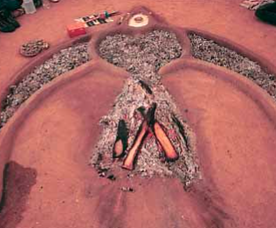
Peyote Meetings
A Native American religion that combines traditional Native American beliefs and Christianity.
Use of peyote for medicinal, spiritual and healing purposes.
The original chapter was established in 1913 in Oklahoma.

Slide 14
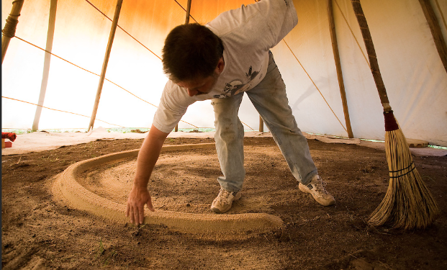
Half-Moon fireplace:
Uses a half-moon shaped sand altar, the color of sand and size used varying between tribes
Uses tobacco and corn-shucks during main sections of the service
Coal design patterns differ from tribe to tribe during the service
Staff is passed around the tipi during singing sections
Ceremonial songs sung

Slide 15
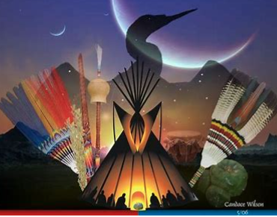
Cross-Fire fireplace:
Uses a horseshoe shaped sand altar, with mound outside of the tipi parallel to the firepit – to represent the "grave of Jesus Christ"
Staff is placed upright in the ground and does not get passed around
Bible sections are recited and used according to the family's prayer for the particular service
Cross design within the coals to represent certain elements of Jesus Christ

Slide 16
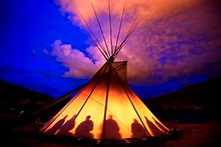
Ceremonies last all night, beginning in the evening and ending in the morning. Morning Water is brought in by a woman after she has prayed and ask the Creator to bless it before everyone drinks from the bucket.
Maheo is the Northern Cheyenne name for the Creator.

Slide 17
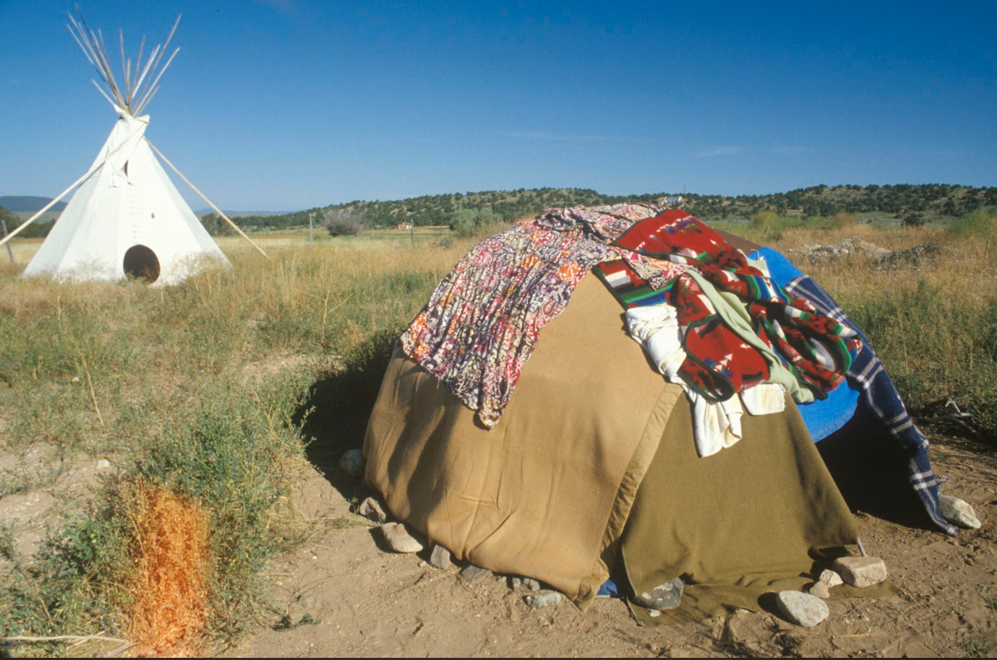
Services are run by a Roadman and is assisted by a Fireman, whose task is to care for the holy fireplace, making sure that it burns consistently all night.
Reasons for holding a meeting: cure illness, birthday celebrations, Christian holidays, school graduations, and other significant life events

Slide 18
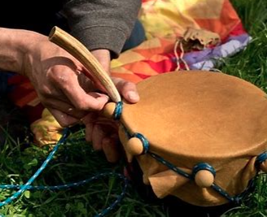
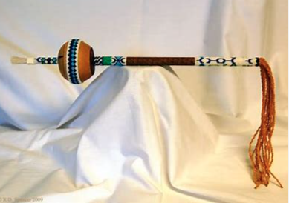
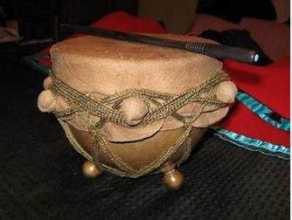


Slide 19
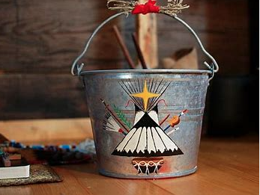
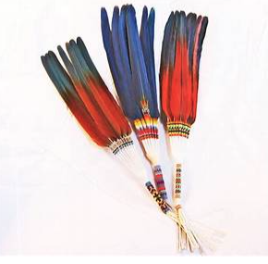
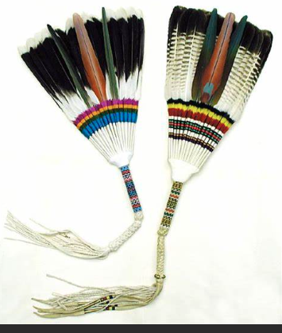
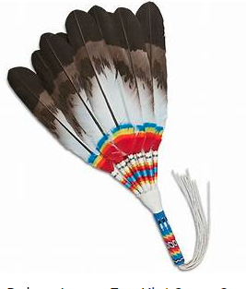
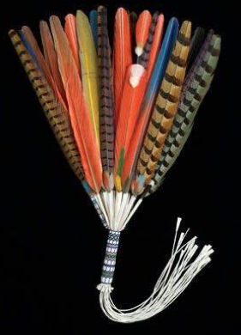

Slide 20
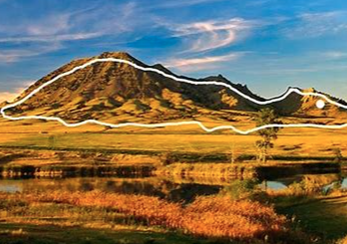
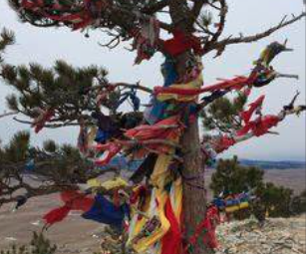
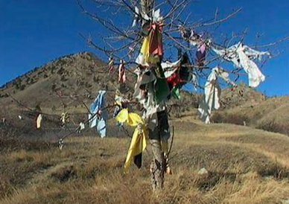
Fasting
Many fast at our most sacred site, Bear Butte in South Dakota. Fasting can also occur a chosen remote site, away from people, traffic.
If you see prayer clothes hanging do not enter that area, someone could be fasting and praying

Slide 21
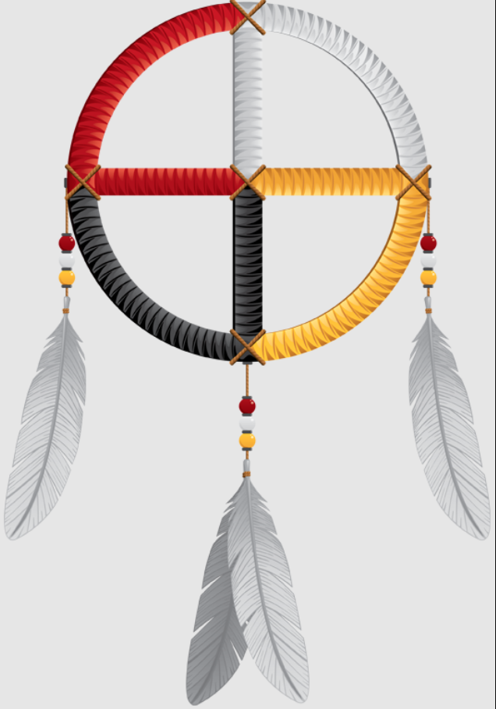
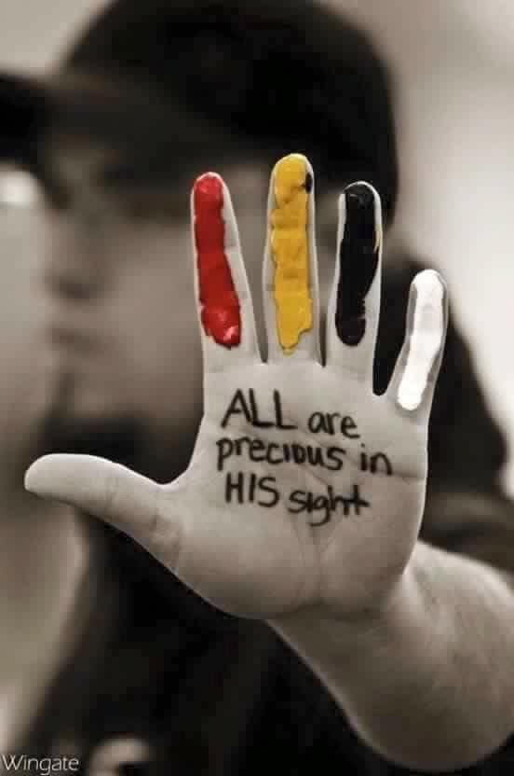
There are four main medicines:
Sweet Grass
Sage
Cedar
Tobacco

Slide 22
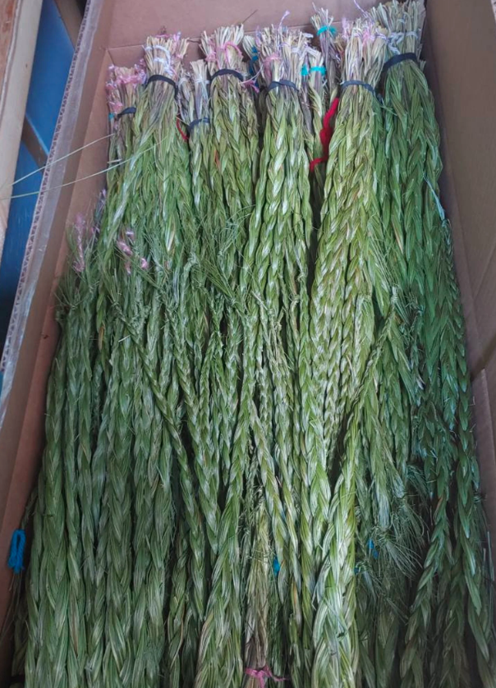
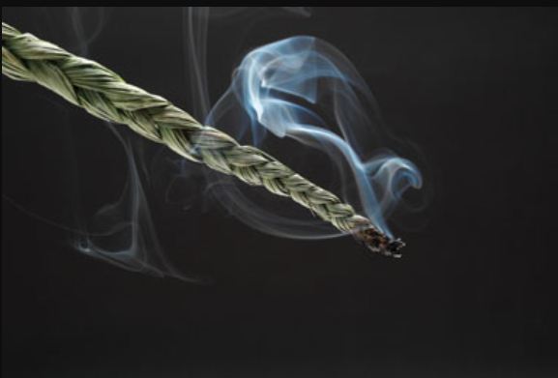
Sweet Grass
Widely used by various tribes with many different purposes. Used to smudge and pray for blessing, protections and well being in mind, body an spirit.
The 3 braids represent different things for different tribes
There are also different patterns for smudge the body with the smoke.
Commonly seen on dashboards or handing from rearview mirrors, used for protection. I was taught to smudge before a long trip, along with other passengers and to ask for a safe journey

Slide 23
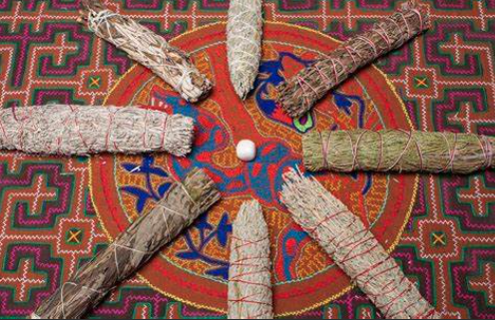
Sage
Many different types
Northern Cheyenne
Man sage: straight lone pieces of sage, no flowers
Woman sage: grow in bunces, can have flowers
Different sage is used for different things. Man sage is used during the Sundance. People take the sage and keep to burn during the year.

Slide 24
Cedar
Used to protect
Used for smudging home for new owners, after a death, or to get rid of spirits in your home.
Used after frightening events, near death experiences or bad omens
Loose cedar is burned on stove or over charcoal
Some use cedar smudging sticks
Many different types of cedar can be used
Flat cedar is highly prized and given as gifts.

Slide 25
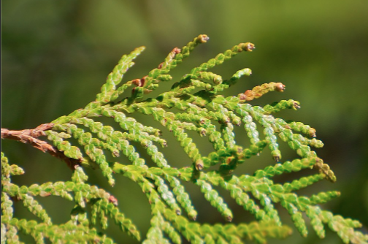
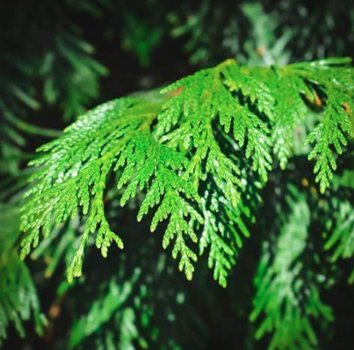
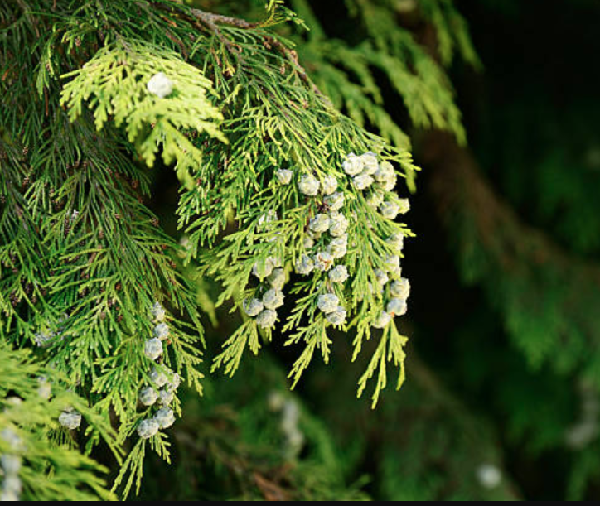

Slide 26
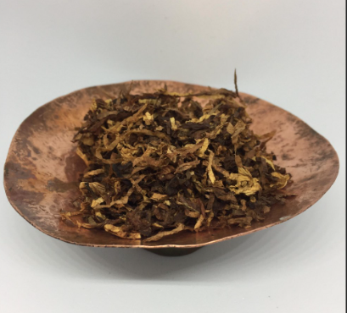
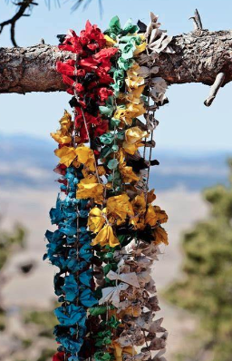
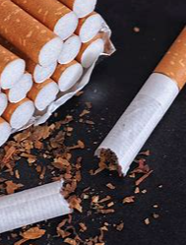
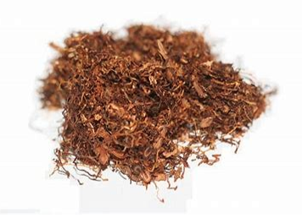
Tobacco
Tobacco is frequently used as an offering, gift, to give thanks, to make a request for wisdom or protection, or as a means of prayer. The smoke carries prayers to Maheo.
Numerous ceremonies
Offering to Maheo
Smoke rituals/prayers
Used as a gift or asking for help
Pouch tobacco and commercial tobacco can be used

Slide 27
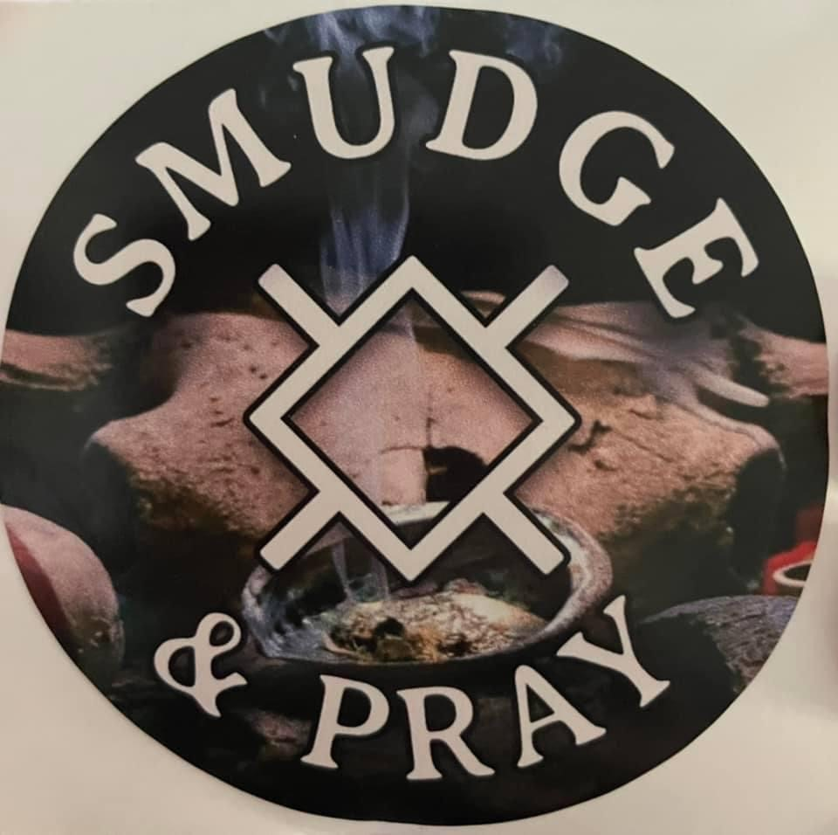
The Northern Cheyenne use tobacco during the Sundance, fasting, daily prayers and other ceremonies.
I was taught to offer tobacco at sunrise for 7 days when asking for protection, improved health of a loved one, or other serious events not routinely faced.

Slide 28
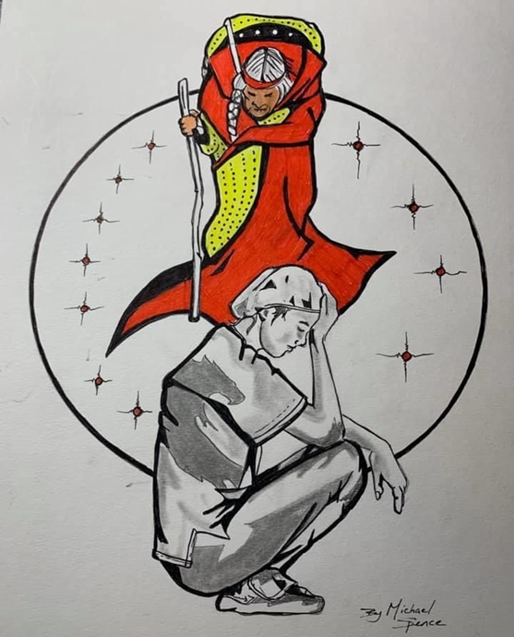
My grandparent’s taught me that prayer is the first thing you do when you wake up and the last thing you do when you go to bed.
Always be grateful to Maheo for the blessings he has given you and your family: time with your family, love, caring, kindness, health, and knowledge.
Pray for those who are ill, those suffering from addictions, those who are in mourning, those who are serving in the armed services, the lonely and the lost.
Remember to pray for yourself.
There is ALWAYS something to be grateful for.
Grandmother’s Prayers

Slide 29
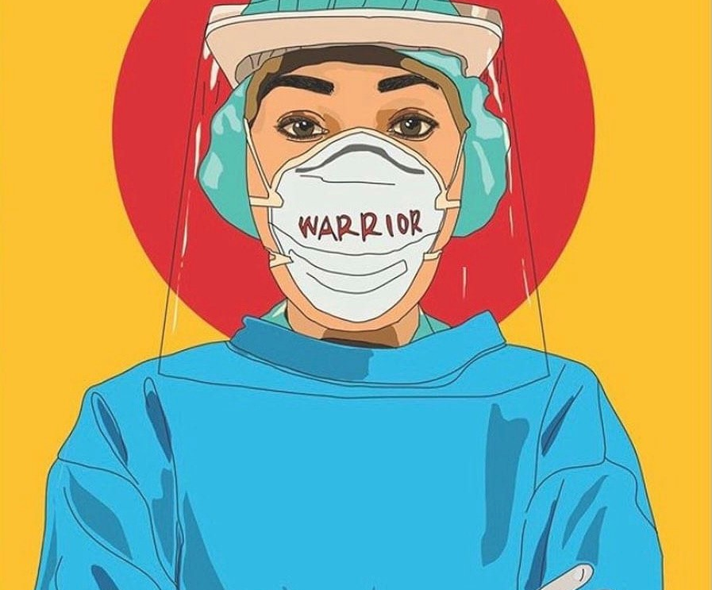
It is an honor for me to share my culture and knowledge of my Northern Cheyenne heritage. Always remember to pray.
Néá'eše

